Slide 1
Name data, usa
https://www.kaggle.com/datagov/usa-names

Slide 2
Statistical questions
What are the most common male and female names throughout the years?
Which year had more males vs females?
Over all the years, are there more males or females?
Which states have more males? Females?
What year had the most name occurrences?

Slide 3
Variables: meaning
STATE: 2-digit state code
GENDER: Sex (M = Male, F = Female)
YEAR: 4-digit year of birth
NAME: Name at birth
NUMBER: Number of occurrences of the name

Slide 4
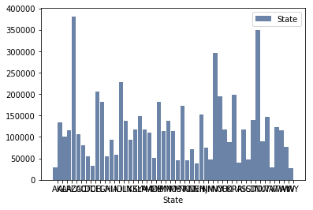
Histogram of state variable

Slide 5
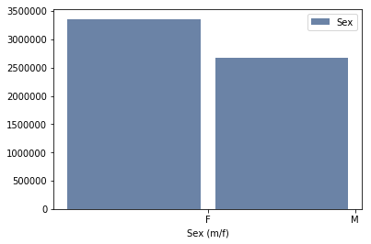
Histogram of sex (M/F) Variable

Slide 6
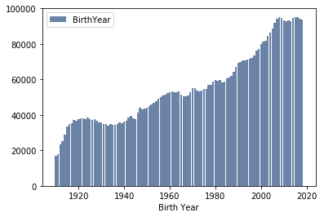
histogram of Birth year variable

Slide 7
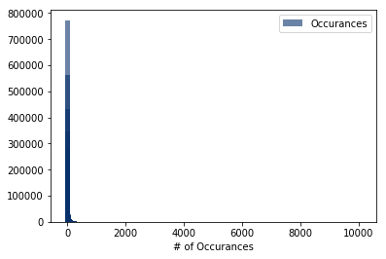
Histogram of occurrences variable

Slide 8
Variable characteristics
Birth Year –
  Mean: 1975.2
  Variance: 934.3
  Standard Deviation: 30.6
Occurrences –
  Mean: 51.6
  Variance: 31097.6
  Standard Deviation: 176.3

Slide 9
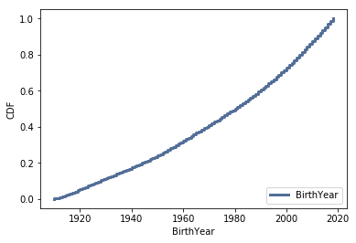
Cumulative distribution function (CDF)
CDF range from .002 - 0.98 over the years.
The earlier years are in the .02 percentile and the later years are closer to the 98 percentile.

Slide 10
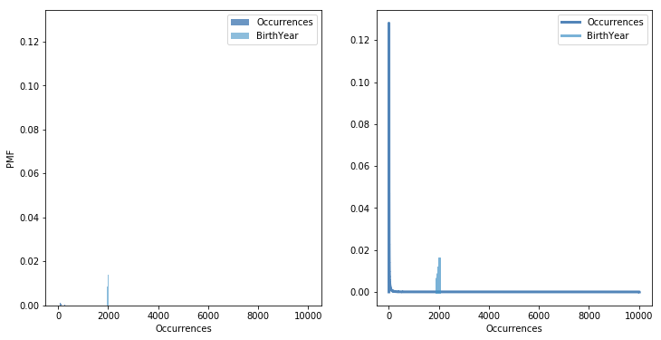
Compare two scenerios using a PMF

Slide 11
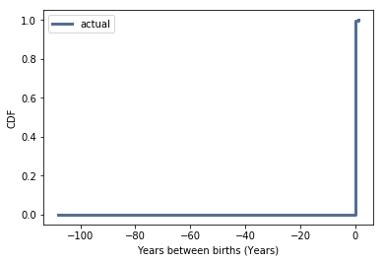
exponential distribution
Exponential distribution is not being shown for the Years between births

Slide 12
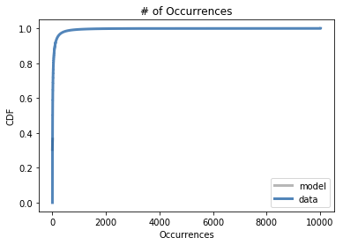
Normal distribution
Normal distribution plot for # of occurrences of names

Slide 13
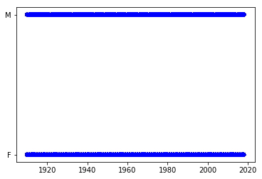
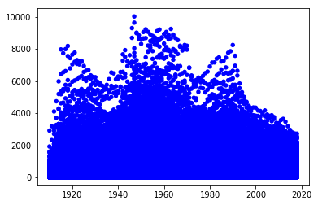
Scatter plots comparing two variables
Birth year versus sex
Birth Year versus Occurrence
Pearson’s : -.001
Spearman’s: 0.0001

Slide 14
Hypothesis testing
It was determined that there was no relationship between the gender of the baby and how many times either male or female had occurred within the year.

Slide 15
Regression analysis
OLS Regression Results
Dep. Variable: nsdf2.BirthYear R-squared: 0.000
Model: OLS Adj. R-squared: 0.000
Method: Least Squares F-statistic: 2.034
Date: Sat, 10 Aug 2019 Prob (F-statistic): 0.154
Time: 12:46:32 Log-Likelihood: -1.3646e+05
No. Observations: 188016 AIC: 2.729e+05
Df Residuals: 188014 BIC: 2.729e+05
Df Model: 1
Covariance Type: nonrobust
coef std err t P>|t| [0.025 0.975]
Intercept 2017.4990 0.001 1.63e+06 0.000 2017.497 2017.501
nsdf2.Occurrences -2.049e-05 1.44e-05 -1.426 0.154 -4.87e-05 7.67e-06
Omnibus: 640545.310 Durbin-Watson: 0.004
Prob(Omnibus): 0.000 Jarque-Bera (JB): 31334.646
Skew: 0.007 Prob(JB): 0.00
Kurtosis: 1.000 Cond. No. 92.7

